Slide 1
SOA Exam FM
Module 3 – Section 6 (Part 1)
Bond Amortization Table

Slide 2
Example
You buy a 4-year 1000 face value bond, redeemable at par, with 6% annual coupons. Determine the price of the bond to yield 3% annual effective.

Slide 3







Example
You buy a 4-year 1000 face value bond, redeemable at par, with 6% annual coupons. Determine the price of the bond to yield 3% annual effective.
$$1000$$
$$60$$
$$60$$
$$60$$
$$60$$
$$1$$
$$2$$
$$3$$
$$4$$
$$P$$

Slide 4

Example
You buy a 4-year 1000 face value bond, redeemable at par, with 6% annual coupons. Determine the price of the bond to yield 3% annual effective.
$$1000$$
$$60$$
$$60$$
$$60$$
$$60$$
$$1$$
$$2$$
$$3$$
$$4$$
$$P$$
$$=60a_{\overline{4}|0.03}+1000v_{0.03}^{4}$$

Slide 5

Example
You buy a 4-year 1000 face value bond, redeemable at par, with 6% annual coupons. Determine the price of the bond to yield 3% annual effective.
$$1000$$
$$60$$
$$60$$
$$60$$
$$60$$
$$1$$
$$2$$
$$3$$
$$4$$
$$P$$
$$=60a_{\overline{4}|0.03}+1000v_{0.03}^{4}$$
$$=1111.51$$

Slide 6
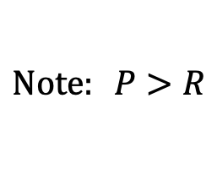
Example
You buy a 4-year 1000 face value bond, redeemable at par, with 6% annual coupons. Determine the price of the bond to yield 3% annual effective.
$$1000$$
$$60$$
$$60$$
$$60$$
$$60$$
$$1$$
$$2$$
$$3$$
$$4$$
$$P$$
$$=60a_{\overline{4}|0.03}+1000v_{0.03}^{4}$$
$$=1111.51$$
$$Note: P>R$$

Slide 7
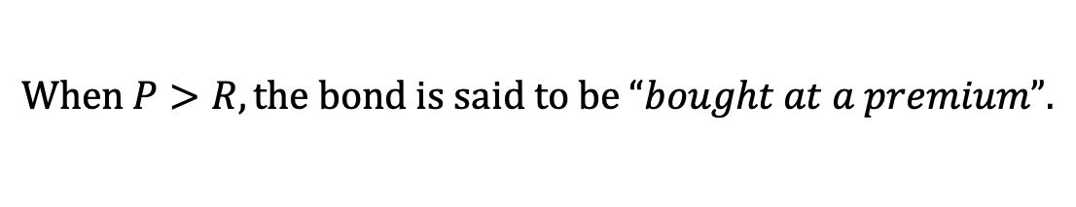
Example
You buy a 4-year 1000 face value bond, redeemable at par, with 6% annual coupons. Determine the price of the bond to yield 3% annual effective.
$$1000$$
$$60$$
$$60$$
$$60$$
$$60$$
$$1$$
$$2$$
$$3$$
$$4$$
$$P$$
$$=60a_{\overline{4}|0.03}+1000v_{0.03}^{4}$$
$$=1111.51$$
$$Note: P>R$$
$$When P>R, the bond is said to be “bought at a premium”.$$

Slide 8
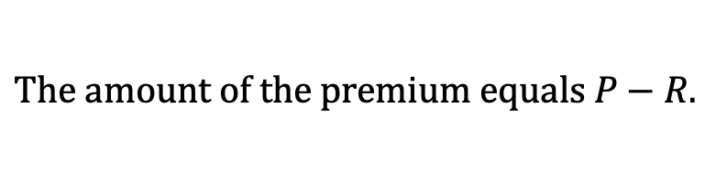
Example
You buy a 4-year 1000 face value bond, redeemable at par, with 6% annual coupons. Determine the price of the bond to yield 3% annual effective.
$$1000$$
$$60$$
$$60$$
$$60$$
$$60$$
$$1$$
$$2$$
$$3$$
$$4$$
$$P$$
$$=60a_{\overline{4}|0.03}+1000v_{0.03}^{4}$$
$$=1111.51$$
$$Note: P>R$$
$$When P>R, the bond is said to be “bought at a premium”.$$
$$The amount of the premium equals P−R.$$

Slide 9
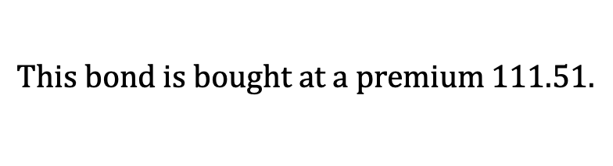
Example
You buy a 4-year 1000 face value bond, redeemable at par, with 6% annual coupons. Determine the price of the bond to yield 3% annual effective.
$$1000$$
$$60$$
$$60$$
$$60$$
$$60$$
$$1$$
$$2$$
$$3$$
$$4$$
$$P$$
$$=60a_{\overline{4}|0.03}+1000v_{0.03}^{4}$$
$$=1111.51$$
$$This bond is bought at a premium 111.51.$$

Slide 10


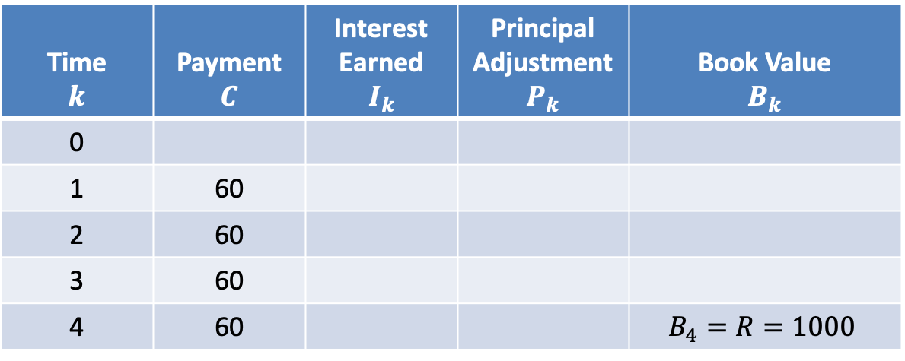
$$Amortization Table$$
$$i=0.03$$
Time $$k$$ | Payment $$C$$ | Interest Earned $$I_{k}$$ | Principal Adjustment $$P_{k}$$ | Book Value $$B_{k}$$
0
1 | 60
2 | 60
3 | 60
4 | 60 |  |  | $$B_{4}=R=1000$$

Slide 11
$$Amortization Table$$
$$i=0.03$$
Time $$k$$ | Payment $$C$$ | Interest Earned $$I_{k}$$ | Principal Adjustment $$P_{k}$$ | Book Value $$B_{k}$$
0
1 | 60
2 | 60
3 | 60
4 | 60 |  |  | $$B_{4}=R=1000$$
$$P$$
$$=60a_{\overline{4}|0.03}+1000v_{0.03}^{4}$$
$$=1111.51$$

Slide 12
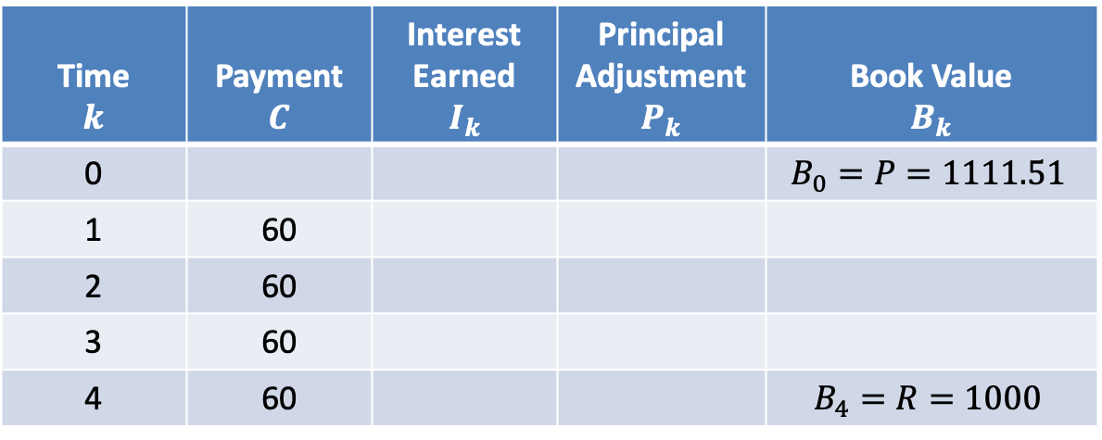
$$Amortization Table$$
$$i=0.03$$
Time $$k$$ | Payment $$C$$ | Interest Earned $$I_{k}$$ | Principal Adjustment $$P_{k}$$ | Book Value $$B_{k}$$
0 |  |  |  | $$B_{0}=P=1111.51$$
1 | 60
2 | 60
3 | 60
4 | 60 |  |  | $$B_{4}=R=1000$$

Slide 13

$$Amortization Table$$
$$i=0.03$$
Time $$k$$ | Payment $$C$$ | Interest Earned $$I_{k}$$ | Principal Adjustment $$P_{k}$$ | Book Value $$B_{k}$$
0 |  |  |  | $$B_{0}=P=1111.51$$
1 | 60
2 | 60
3 | 60
4 | 60 |  |  | $$B_{4}=R=1000$$
$$I_{1}=0.03∙1111.51$$

Slide 14

$$Amortization Table$$
$$i=0.03$$
Time $$k$$ | Payment $$C$$ | Interest Earned $$I_{k}$$ | Principal Adjustment $$P_{k}$$ | Book Value $$B_{k}$$
0 |  |  |  | $$B_{0}=P=1111.51$$
1 | 60
2 | 60
3 | 60
4 | 60 |  |  | $$B_{4}=R=1000$$
$$I_{1}=0.03∙1111.51$$
$$=33.35$$

Slide 15
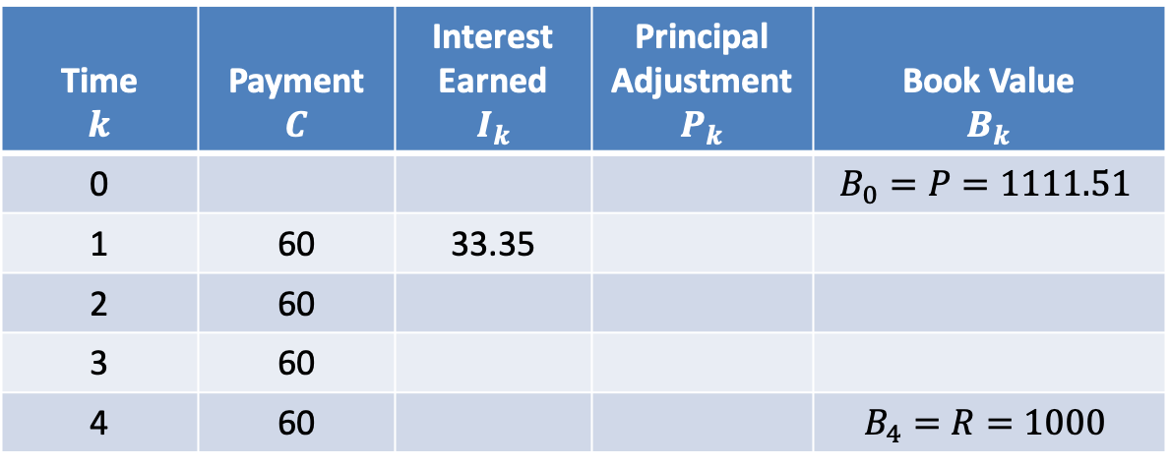
$$Amortization Table$$
$$i=0.03$$
Time $$k$$ | Payment $$C$$ | Interest Earned $$I_{k}$$ | Principal Adjustment $$P_{k}$$ | Book Value $$B_{k}$$
0 |  |  |  | $$B_{0}=P=1111.51$$
1 | 60 | 33.35
2 | 60
3 | 60
4 | 60 |  |  | $$B_{4}=R=1000$$
$$I_{1}=0.03∙1111.51$$
$$=33.35$$

Slide 16

$$Amortization Table$$
$$i=0.03$$
Time $$k$$ | Payment $$C$$ | Interest Earned $$I_{k}$$ | Principal Adjustment $$P_{k}$$ | Book Value $$B_{k}$$
0 |  |  |  | $$B_{0}=P=1111.51$$
1 | 60 | 33.35
2 | 60
3 | 60
4 | 60 |  |  | $$B_{4}=R=1000$$
$$I_{1}=0.03∙1111.51$$
$$=33.35$$
$$P_{1}=60−33.35=26.65$$

Slide 17
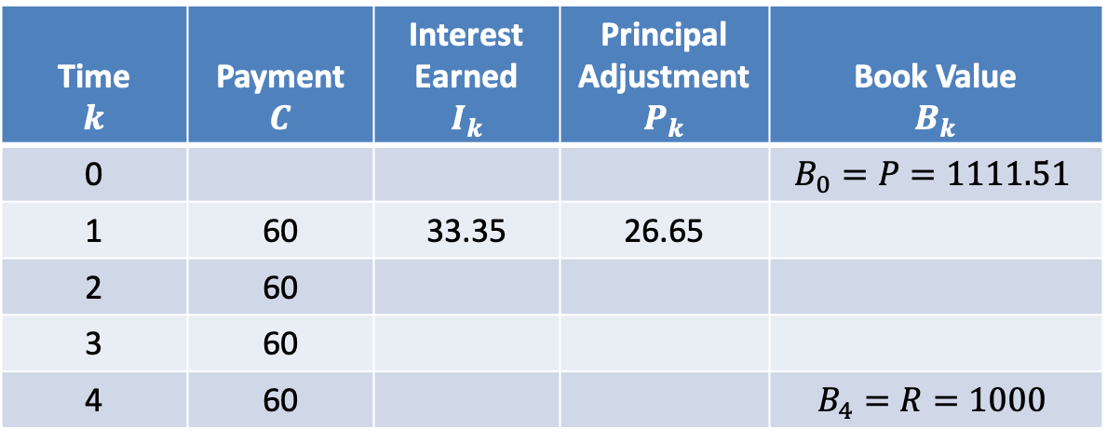
$$Amortization Table$$
$$i=0.03$$
Time $$k$$ | Payment $$C$$ | Interest Earned $$I_{k}$$ | Principal Adjustment $$P_{k}$$ | Book Value $$B_{k}$$
0 |  |  |  | $$B_{0}=P=1111.51$$
1 | 60 | 33.35 | 26.65
2 | 60
3 | 60
4 | 60 |  |  | $$B_{4}=R=1000$$
$$I_{1}=0.03∙1111.51$$
$$=33.35$$
$$P_{1}=60−33.35=26.65$$

Slide 18
$$Amortization Table$$
$$i=0.03$$
Time $$k$$ | Payment $$C$$ | Interest Earned $$I_{k}$$ | Principal Adjustment $$P_{k}$$ | Book Value $$B_{k}$$
0 |  |  |  | $$B_{0}=P=1111.51$$
1 | 60 | 33.35 | 26.65
2 | 60
3 | 60
4 | 60 |  |  | $$B_{4}=R=1000$$
$$I_{1}=0.03∙1111.51$$
$$=33.35$$
$$P_{1}=60−33.35=26.65$$
$$B_{1}=1111.51−26.65=1084.86$$

Slide 19
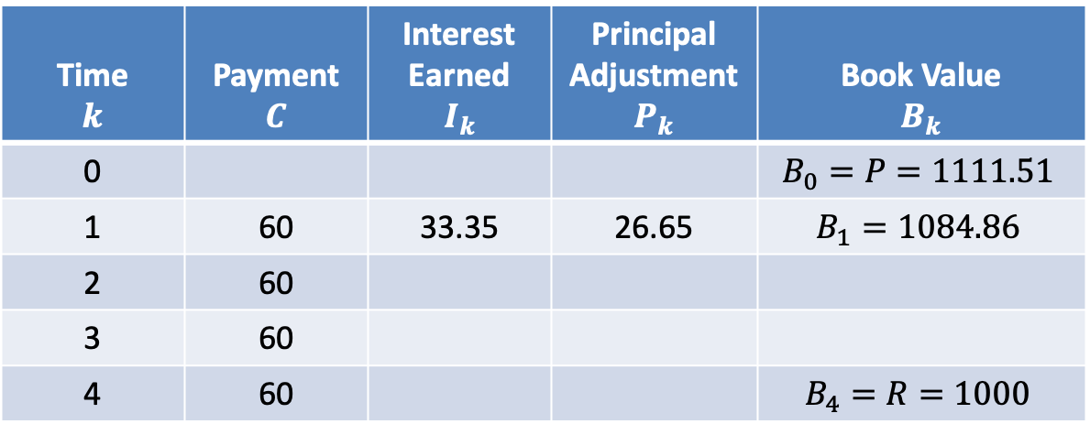
$$Amortization Table$$
$$i=0.03$$
Time $$k$$ | Payment $$C$$ | Interest Earned $$I_{k}$$ | Principal Adjustment $$P_{k}$$ | Book Value $$B_{k}$$
0 |  |  |  | $$B_{0}=P=1111.51$$
1 | 60 | 33.35 | 26.65 | $$B_{1}=1084.86$$
2 | 60
3 | 60
4 | 60 |  |  | $$B_{4}=R=1000$$
$$I_{1}=0.03∙1111.51$$
$$=33.35$$
$$P_{1}=60−33.35=26.65$$
$$B_{1}=1111.51−26.65=1084.86$$

Slide 20

$$Amortization Table$$
$$i=0.03$$
Time $$k$$ | Payment $$C$$ | Interest Earned $$I_{k}$$ | Principal Adjustment $$P_{k}$$ | Book Value $$B_{k}$$
0 |  |  |  | $$B_{0}=P=1111.51$$
1 | 60 | 33.35 | 26.65 | $$B_{1}=1084.86$$
2 | 60
3 | 60
4 | 60 |  |  | $$B_{4}=R=1000$$
$$I_{1}=0.03∙1111.51$$
$$=33.35$$
$$P_{1}=60−33.35=26.65$$
$$B_{1}=1111.51−26.65=1084.86$$
$$Remarks:$$

Slide 21

$$Amortization Table$$
$$i=0.03$$
Time $$k$$ | Payment $$C$$ | Interest Earned $$I_{k}$$ | Principal Adjustment $$P_{k}$$ | Book Value $$B_{k}$$
0 |  |  |  | $$B_{0}=P=1111.51$$
1 | 60 | 33.35 | 26.65 | $$B_{1}=1084.86$$
2 | 60
3 | 60
4 | 60 |  |  | $$B_{4}=R=1000$$
$$I_{1}=0.03∙1111.51$$
$$=33.35$$
$$P_{1}=60−33.35=26.65$$
$$B_{1}=1111.51−26.65=1084.86$$
$$Remarks:$$
$$Retro$$
$$B_{1}=1111.51(1.03)−60=1084.86$$

Slide 22

$$Amortization Table$$
$$i=0.03$$
Time $$k$$ | Payment $$C$$ | Interest Earned $$I_{k}$$ | Principal Adjustment $$P_{k}$$ | Book Value $$B_{k}$$
0 |  |  |  | $$B_{0}=P=1111.51$$
1 | 60 | 33.35 | 26.65 | $$B_{1}=1084.86$$
2 | 60
3 | 60
4 | 60 |  |  | $$B_{4}=R=1000$$
$$I_{1}=0.03∙1111.51$$
$$=33.35$$
$$P_{1}=60−33.35=26.65$$
$$B_{1}=1111.51−26.65=1084.86$$
$$Remarks:$$
$$Retro$$
$$B_{1}=1111.51(1.03)−60=1084.86$$
$$B_{1}=B_{0}(1+i)−C$$

Slide 23

$$Amortization Table$$
$$i=0.03$$
Time $$k$$ | Payment $$C$$ | Interest Earned $$I_{k}$$ | Principal Adjustment $$P_{k}$$ | Book Value $$B_{k}$$
0 |  |  |  | $$B_{0}=P=1111.51$$
1 | 60 | 33.35 | 26.65 | $$B_{1}=1084.86$$
2 | 60
3 | 60
4 | 60 |  |  | $$B_{4}=R=1000$$
$$I_{1}=0.03∙1111.51$$
$$=33.35$$
$$P_{1}=60−33.35=26.65$$
$$B_{1}=1111.51−26.65=1084.86$$
$$Remarks:$$
$$Retro$$
$$B_{1}=1111.51(1.03)−60=1084.86$$
$$B_{1}=B_{0}(1+i)−C$$
$$=B_{0}−P_{1}$$

Slide 24


$$Amortization Table$$
$$i=0.03$$
Time $$k$$ | Payment $$C$$ | Interest Earned $$I_{k}$$ | Principal Adjustment $$P_{k}$$ | Book Value $$B_{k}$$
0 |  |  |  | $$B_{0}=P=1111.51$$
1 | 60 | 33.35 | 26.65 | $$B_{1}=1084.86$$
2 | 60
3 | 60
4 | 60 |  |  | $$B_{4}=R=1000$$
$$I_{1}=0.03∙1111.51$$
$$=33.35$$
$$P_{1}=60−33.35=26.65$$
$$B_{1}=1111.51−26.65=1084.86$$
$$Remarks:$$
$$Pro$$
$$B_{1}=$$
$$60a_{\overline{3}|0.03}+1000v_{0.03}^{3}$$

Slide 25

$$Amortization Table$$
$$i=0.03$$
Time $$k$$ | Payment $$C$$ | Interest Earned $$I_{k}$$ | Principal Adjustment $$P_{k}$$ | Book Value $$B_{k}$$
0 |  |  |  | $$B_{0}=P=1111.51$$
1 | 60 | 33.35 | 26.65 | $$B_{1}=1084.86$$
2 | 60
3 | 60
4 | 60 |  |  | $$B_{4}=R=1000$$
$$I_{1}=0.03∙1111.51$$
$$=33.35$$
$$P_{1}=60−33.35=26.65$$
$$B_{1}=1111.51−26.65=1084.86$$
$$Remarks:$$
$$Pro$$
$$B_{1}=$$
$$60a_{\overline{3}|0.03}+1000v_{0.03}^{3}$$
$$=1084.86$$

Slide 26
$$Amortization Table$$
$$i=0.03$$
Time $$k$$ | Payment $$C$$ | Interest Earned $$I_{k}$$ | Principal Adjustment $$P_{k}$$ | Book Value $$B_{k}$$
0 |  |  |  | $$B_{0}=P=1111.51$$
1 | 60 | 33.35 | 26.65 | $$B_{1}=1084.86$$
2 | 60
3 | 60
4 | 60 |  |  | $$B_{4}=R=1000$$

Slide 27

$$Amortization Table$$
$$i=0.03$$
Time $$k$$ | Payment $$C$$ | Interest Earned $$I_{k}$$ | Principal Adjustment $$P_{k}$$ | Book Value $$B_{k}$$
0 |  |  |  | $$B_{0}=P=1111.51$$
1 | 60 | 33.35 | 26.65 | $$B_{1}=1084.86$$
2 | 60
3 | 60
4 | 60 |  |  | $$B_{4}=R=1000$$
$$I_{2}=0.03∙1084.86$$

Slide 28

$$Amortization Table$$
$$i=0.03$$
Time $$k$$ | Payment $$C$$ | Interest Earned $$I_{k}$$ | Principal Adjustment $$P_{k}$$ | Book Value $$B_{k}$$
0 |  |  |  | $$B_{0}=P=1111.51$$
1 | 60 | 33.35 | 26.65 | $$B_{1}=1084.86$$
2 | 60
3 | 60
4 | 60 |  |  | $$B_{4}=R=1000$$
$$I_{2}=0.03∙1084.86$$
$$=32.55$$

Slide 29
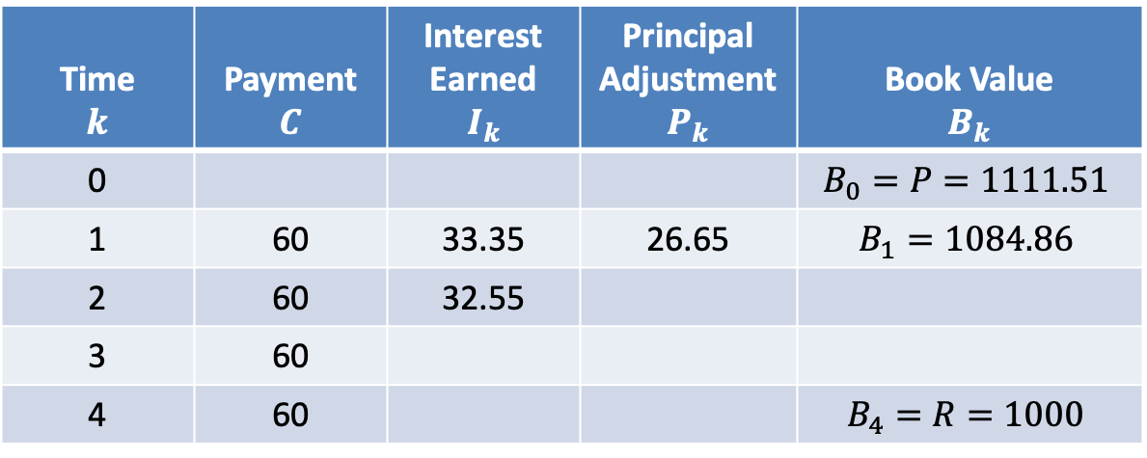
$$Amortization Table$$
$$i=0.03$$
Time $$k$$ | Payment $$C$$ | Interest Earned $$I_{k}$$ | Principal Adjustment $$P_{k}$$ | Book Value $$B_{k}$$
0 |  |  |  | $$B_{0}=P=1111.51$$
1 | 60 | 33.35 | 26.65 | $$B_{1}=1084.86$$
2 | 60 | 32.55
3 | 60
4 | 60 |  |  | $$B_{4}=R=1000$$
$$I_{2}=0.03∙1084.86$$
$$=32.55$$

Slide 30

$$Amortization Table$$
$$i=0.03$$
Time $$k$$ | Payment $$C$$ | Interest Earned $$I_{k}$$ | Principal Adjustment $$P_{k}$$ | Book Value $$B_{k}$$
0 |  |  |  | $$B_{0}=P=1111.51$$
1 | 60 | 33.35 | 26.65 | $$B_{1}=1084.86$$
2 | 60 | 32.55
3 | 60
4 | 60 |  |  | $$B_{4}=R=1000$$
$$I_{2}=0.03∙1084.86$$
$$=32.55$$
$$P_{2}=60−32.55=27.45$$

Slide 31
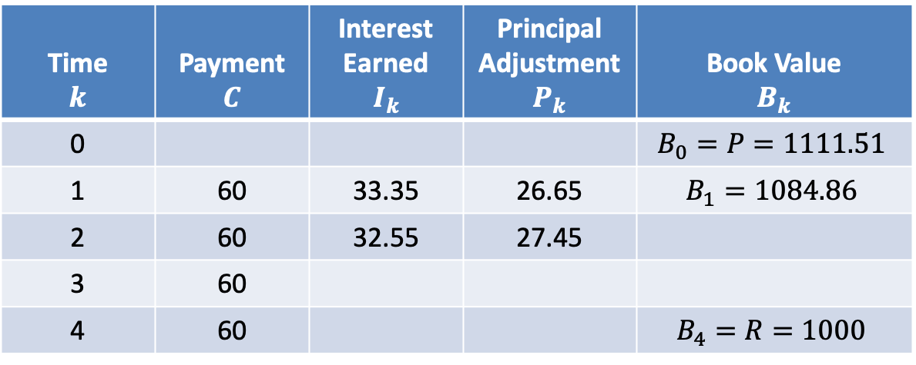
$$Amortization Table$$
$$i=0.03$$
Time $$k$$ | Payment $$C$$ | Interest Earned $$I_{k}$$ | Principal Adjustment $$P_{k}$$ | Book Value $$B_{k}$$
0 |  |  |  | $$B_{0}=P=1111.51$$
1 | 60 | 33.35 | 26.65 | $$B_{1}=1084.86$$
2 | 60 | 32.55 | 27.45
3 | 60
4 | 60 |  |  | $$B_{4}=R=1000$$
$$I_{2}=0.03∙1084.86$$
$$=32.55$$
$$P_{2}=60−32.55=27.45$$

Slide 32
$$Amortization Table$$
$$i=0.03$$
Time $$k$$ | Payment $$C$$ | Interest Earned $$I_{k}$$ | Principal Adjustment $$P_{k}$$ | Book Value $$B_{k}$$
0 |  |  |  | $$B_{0}=P=1111.51$$
1 | 60 | 33.35 | 26.65 | $$B_{1}=1084.86$$
2 | 60 | 32.55 | 27.45
3 | 60
4 | 60 |  |  | $$B_{4}=R=1000$$
$$I_{2}=0.03∙1084.86$$
$$=32.55$$
$$P_{2}=60−32.55=27.45$$
$$B_{2}=1084.86−27.45=1057.41$$

Slide 33
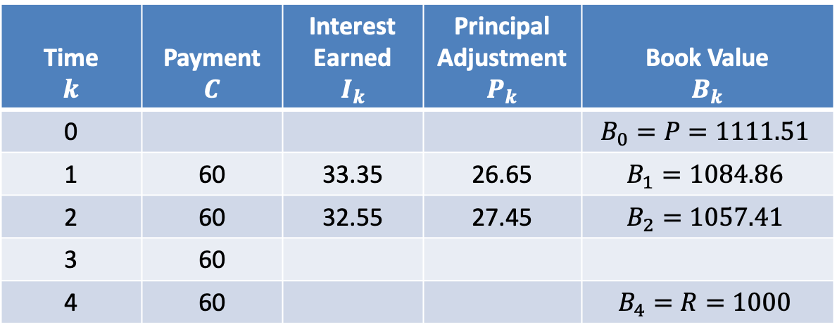
$$Amortization Table$$
$$i=0.03$$
Time $$k$$ | Payment $$C$$ | Interest Earned $$I_{k}$$ | Principal Adjustment $$P_{k}$$ | Book Value $$B_{k}$$
0 |  |  |  | $$B_{0}=P=1111.51$$
1 | 60 | 33.35 | 26.65 | $$B_{1}=1084.86$$
2 | 60 | 32.55 | 27.45 | $$B_{2}=1057.41$$
3 | 60
4 | 60 |  |  | $$B_{4}=R=1000$$
$$I_{2}=0.03∙1084.86$$
$$=32.55$$
$$P_{2}=60−32.55=27.45$$
$$B_{2}=1084.86−27.45=1057.41$$

Slide 34


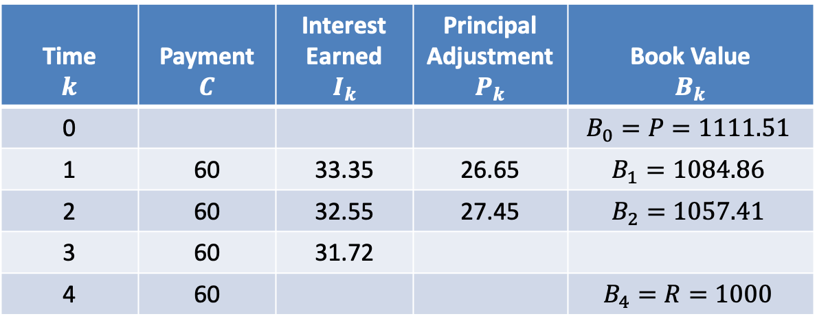
$$Amortization Table$$
$$i=0.03$$
Time $$k$$ | Payment $$C$$ | Interest Earned $$I_{k}$$ | Principal Adjustment $$P_{k}$$ | Book Value $$B_{k}$$
0 |  |  |  | $$B_{0}=P=1111.51$$
1 | 60 | 33.35 | 26.65 | $$B_{1}=1084.86$$
2 | 60 | 32.55 | 27.45 | $$B_{2}=1057.41$$
3 | 60 | 31.72
4 | 60 |  |  | $$B_{4}=R=1000$$
$$I_{3}=0.03∙1057.41$$
$$=31.72$$

Slide 35

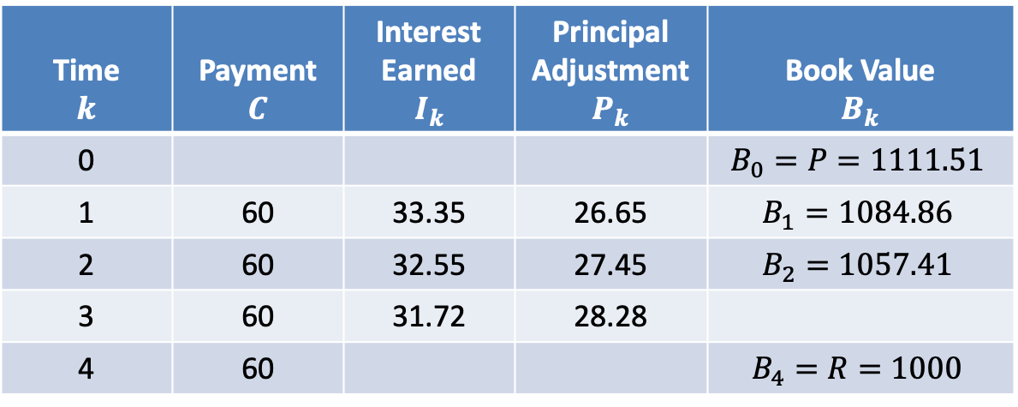
$$Amortization Table$$
$$i=0.03$$
Time $$k$$ | Payment $$C$$ | Interest Earned $$I_{k}$$ | Principal Adjustment $$P_{k}$$ | Book Value $$B_{k}$$
0 |  |  |  | $$B_{0}=P=1111.51$$
1 | 60 | 33.35 | 26.65 | $$B_{1}=1084.86$$
2 | 60 | 32.55 | 27.45 | $$B_{2}=1057.41$$
3 | 60 | 31.72 | 28.28
4 | 60 |  |  | $$B_{4}=R=1000$$
$$I_{3}=0.03∙1057.41$$
$$=31.72$$
$$P_{3}=60−31.72=28.28$$

Slide 36
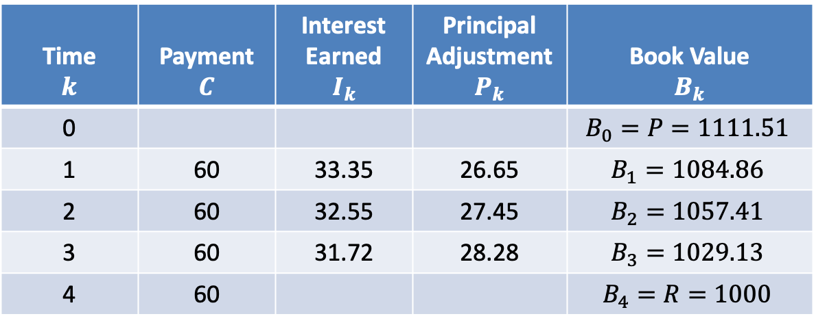
$$Amortization Table$$
$$i=0.03$$
Time $$k$$ | Payment $$C$$ | Interest Earned $$I_{k}$$ | Principal Adjustment $$P_{k}$$ | Book Value $$B_{k}$$
0 |  |  |  | $$B_{0}=P=1111.51$$
1 | 60 | 33.35 | 26.65 | $$B_{1}=1084.86$$
2 | 60 | 32.55 | 27.45 | $$B_{2}=1057.41$$
3 | 60 | 31.72 | 28.28 | $$B_{3}=1029.13$$
4 | 60 |  |  | $$B_{4}=R=1000$$
$$I_{3}=0.03∙1057.41$$
$$=31.72$$
$$P_{3}=60−31.72=28.28$$
$$B_{3}=1057.41−28.28=1029.13$$

Slide 37

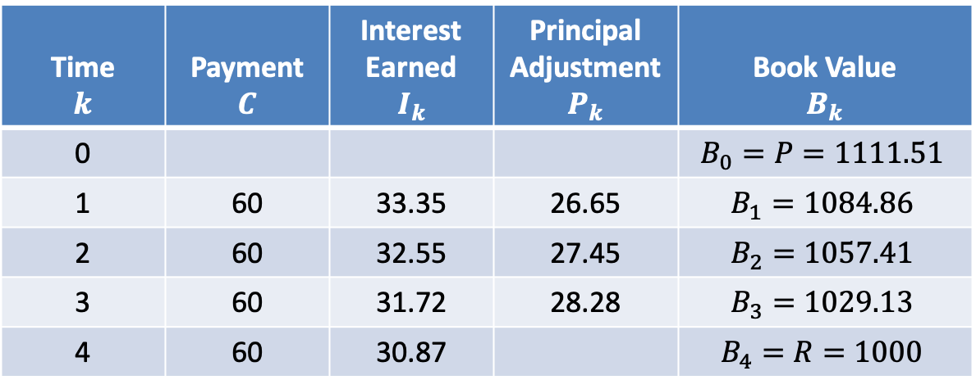
$$Amortization Table$$
$$i=0.03$$
Time $$k$$ | Payment $$C$$ | Interest Earned $$I_{k}$$ | Principal Adjustment $$P_{k}$$ | Book Value $$B_{k}$$
0 |  |  |  | $$B_{0}=P=1111.51$$
1 | 60 | 33.35 | 26.65 | $$B_{1}=1084.86$$
2 | 60 | 32.55 | 27.45 | $$B_{2}=1057.41$$
3 | 60 | 31.72 | 28.28 | $$B_{3}=1029.13$$
4 | 60 | 30.87 |  | $$B_{4}=R=1000$$
$$I_{4}=0.03∙1029.14=30.87$$

Slide 38

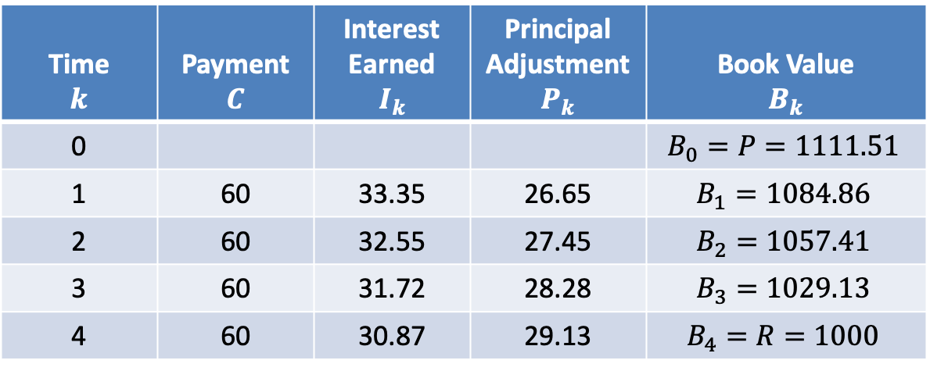
$$Amortization Table$$
$$i=0.03$$
Time $$k$$ | Payment $$C$$ | Interest Earned $$I_{k}$$ | Principal Adjustment $$P_{k}$$ | Book Value $$B_{k}$$
0 |  |  |  | $$B_{0}=P=1111.51$$
1 | 60 | 33.35 | 26.65 | $$B_{1}=1084.86$$
2 | 60 | 32.55 | 27.45 | $$B_{2}=1057.41$$
3 | 60 | 31.72 | 28.28 | $$B_{3}=1029.13$$
4 | 60 | 30.87 | 29.13 | $$B_{4}=R=1000$$
$$I_{4}=0.03∙1029.14=30.87$$
$$P_{4}=60−30.88=29.13$$

Slide 39
$$Amortization Table$$
$$i=0.03$$
Time $$k$$ | Payment $$C$$ | Interest Earned $$I_{k}$$ | Principal Adjustment $$P_{k}$$ | Book Value $$B_{k}$$
0 |  |  |  | $$B_{0}=P=1111.51$$
1 | 60 | 33.35 | 26.65 | $$B_{1}=1084.86$$
2 | 60 | 32.55 | 27.45 | $$B_{2}=1057.41$$
3 | 60 | 31.72 | 28.28 | $$B_{3}=1029.13$$
4 | 60 | 30.87 | 29.13 | $$B_{4}=R=1000$$
$$I_{4}=0.03∙1029.14=30.87$$
$$P_{4}=60−30.88=29.13$$
$$B_{4}=1029.14−29.12=1000$$

Slide 40
$$Amortization Table$$
$$i=0.03$$
Time $$k$$ | Payment $$C$$ | Interest Earned $$I_{k}$$ | Principal Adjustment $$P_{k}$$ | Book Value $$B_{k}$$
0 |  |  |  | $$B_{0}=P=1111.51$$
1 | 60 | 33.35 | 26.65 | $$B_{1}=1084.86$$
2 | 60 | 32.55 | 27.45 | $$B_{2}=1057.41$$
3 | 60 | 31.72 | 28.28 | $$B_{3}=1029.13$$
4 | 60 | 30.87 | 29.13 | $$B_{4}=R=1000$$

Slide 41

$$Amortization Table$$
$$i=0.03$$
Time $$k$$ | Payment $$C$$ | Interest Earned $$I_{k}$$ | Principal Adjustment $$P_{k}$$ | Book Value $$B_{k}$$
0 |  |  |  | $$B_{0}=P=1111.51$$
1 | 60 | 33.35 | 26.65 | $$B_{1}=1084.86$$
2 | 60 | 32.55 | 27.45 | $$B_{2}=1057.41$$
3 | 60 | 31.72 | 28.28 | $$B_{3}=1029.13$$
4 | 60 | 30.87 | 29.13 | $$B_{4}=R=1000$$
$$Σ=111.51$$

Slide 42

$$Amortization Table$$
$$i=0.03$$
Time $$k$$ | Payment $$C$$ | Interest Earned $$I_{k}$$ | Principal Adjustment $$P_{k}$$ | Book Value $$B_{k}$$
0 |  |  |  | $$B_{0}=P=1111.51$$
1 | 60 | 33.35 | 26.65 | $$B_{1}=1084.86$$
2 | 60 | 32.55 | 27.45 | $$B_{2}=1057.41$$
3 | 60 | 31.72 | 28.28 | $$B_{3}=1029.13$$
4 | 60 | 30.87 | 29.13 | $$B_{4}=R=1000$$
$$Σ=111.51$$
$$=B_{0}−B_{4}$$

Slide 43

$$Amortization Table$$
$$i=0.03$$
Time $$k$$ | Payment $$C$$ | Interest Earned $$I_{k}$$ | Principal Adjustment $$P_{k}$$ | Book Value $$B_{k}$$
0 |  |  |  | $$B_{0}=P=1111.51$$
1 | 60 | 33.35 | 26.65 | $$B_{1}=1084.86$$
2 | 60 | 32.55 | 27.45 | $$B_{2}=1057.41$$
3 | 60 | 31.72 | 28.28 | $$B_{3}=1029.13$$
4 | 60 | 30.87 | 29.13 | $$B_{4}=R=1000$$
$$Σ=111.51$$
$$=B_{0}−B_{4}$$
$$=P−R$$

Slide 44

$$Amortization Table$$
$$i=0.03$$
Time $$k$$ | Payment $$C$$ | Interest Earned $$I_{k}$$ | Principal Adjustment $$P_{k}$$ | Book Value $$B_{k}$$
0 |  |  |  | $$B_{0}=P=1111.51$$
1 | 60 | 33.35 | 26.65 | $$B_{1}=1084.86$$
2 | 60 | 32.55 | 27.45 | $$B_{2}=1057.41$$
3 | 60 | 31.72 | 28.28 | $$B_{3}=1029.13$$
4 | 60 | 30.87 | 29.13 | $$B_{4}=R=1000$$
$$Σ=111.51$$
$$=B_{0}−B_{4}$$
$$=P−R$$
$$=Premium$$

Slide 45
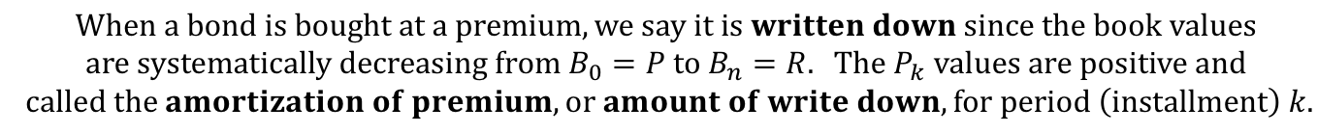
$$Amortization Table$$
$$i=0.03$$
Time $$k$$ | Payment $$C$$ | Interest Earned $$I_{k}$$ | Principal Adjustment $$P_{k}$$ | Book Value $$B_{k}$$
0 |  |  |  | $$B_{0}=P=1111.51$$
1 | 60 | 33.35 | 26.65 | $$B_{1}=1084.86$$
2 | 60 | 32.55 | 27.45 | $$B_{2}=1057.41$$
3 | 60 | 31.72 | 28.28 | $$B_{3}=1029.13$$
4 | 60 | 30.87 | 29.13 | $$B_{4}=R=1000$$
$$Σ=111.51$$
$$=B_{0}−B_{4}$$
$$=P−R$$
$$=Premium$$
$$When a bond is bought at a premium, we say it is written down since the book values \\ are systematically decreasing from B_{0}=P to B_{n}=R. The P_{k} values are positive and$$
$$called the amortization of premium, or amount of write down, for period \left(installment\right) k.$$

Slide 46
$$Amortization Table$$
$$i=0.03$$
Time $$k$$ | Payment $$C$$ | Interest Earned $$I_{k}$$ | Principal Adjustment $$P_{k}$$ | Book Value $$B_{k}$$
0 |  |  |  | $$B_{0}=P=1111.51$$
1 | 60 | 33.35 | 26.65 | $$B_{1}=1084.86$$
2 | 60 | 32.55 | 27.45 | $$B_{2}=1057.41$$
3 | 60 | 31.72 | 28.28 | $$B_{3}=1029.13$$
4 | 60 | 30.87 | 29.13 | $$B_{4}=R=1000$$

Slide 47

$$Amortization Table$$
$$i=0.03$$
Time $$k$$ | Payment $$C$$ | Interest Earned $$I_{k}$$ | Principal Adjustment $$P_{k}$$ | Book Value $$B_{k}$$
0 |  |  |  | $$B_{0}=P=1111.51$$
1 | 60 | 33.35 | 26.65 | $$B_{1}=1084.86$$
2 | 60 | 32.55 | 27.45 | $$B_{2}=1057.41$$
3 | 60 | 31.72 | 28.28 | $$B_{3}=1029.13$$
4 | 60 | 30.87 | 29.13 | $$B_{4}=R=1000$$
$$\frac{27.45}{26.65}=1.03$$

Slide 48

$$Amortization Table$$
$$i=0.03$$
Time $$k$$ | Payment $$C$$ | Interest Earned $$I_{k}$$ | Principal Adjustment $$P_{k}$$ | Book Value $$B_{k}$$
0 |  |  |  | $$B_{0}=P=1111.51$$
1 | 60 | 33.35 | 26.65 | $$B_{1}=1084.86$$
2 | 60 | 32.55 | 27.45 | $$B_{2}=1057.41$$
3 | 60 | 31.72 | 28.28 | $$B_{3}=1029.13$$
4 | 60 | 30.87 | 29.13 | $$B_{4}=R=1000$$
$$\frac{27.45}{26.65}=1.03$$
$$\frac{28.28}{27.45}=1.03$$

Slide 49

$$Amortization Table$$
$$i=0.03$$
Time $$k$$ | Payment $$C$$ | Interest Earned $$I_{k}$$ | Principal Adjustment $$P_{k}$$ | Book Value $$B_{k}$$
0 |  |  |  | $$B_{0}=P=1111.51$$
1 | 60 | 33.35 | 26.65 | $$B_{1}=1084.86$$
2 | 60 | 32.55 | 27.45 | $$B_{2}=1057.41$$
3 | 60 | 31.72 | 28.28 | $$B_{3}=1029.13$$
4 | 60 | 30.87 | 29.13 | $$B_{4}=R=1000$$
$$\frac{27.45}{26.65}=1.03$$
$$\frac{28.28}{27.45}=1.03$$
$$\frac{29.13}{28.28}=1.03$$

Slide 50
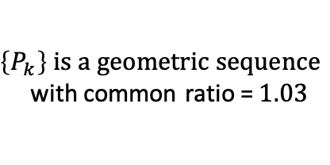
$$Amortization Table$$
$$i=0.03$$
Time $$k$$ | Payment $$C$$ | Interest Earned $$I_{k}$$ | Principal Adjustment $$P_{k}$$ | Book Value $$B_{k}$$
0 |  |  |  | $$B_{0}=P=1111.51$$
1 | 60 | 33.35 | 26.65 | $$B_{1}=1084.86$$
2 | 60 | 32.55 | 27.45 | $$B_{2}=1057.41$$
3 | 60 | 31.72 | 28.28 | $$B_{3}=1029.13$$
4 | 60 | 30.87 | 29.13 | $$B_{4}=R=1000$$
$$\frac{27.45}{26.65}=1.03$$
$$\frac{28.28}{27.45}=1.03$$
$\left\{P_{k}\right\} is a geometric sequence$
with common ratio =$1.03$
$$\frac{29.13}{28.28}=1.03$$

Slide 51
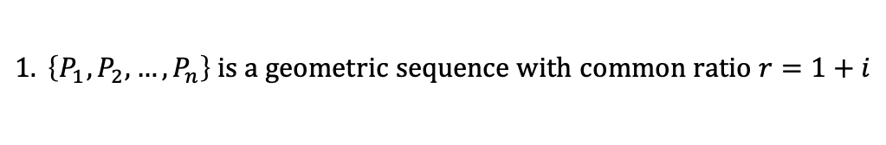

$$Amortization Table$$
$$i=0.03$$
Time $$k$$ | Payment $$C$$ | Interest Earned $$I_{k}$$ | Principal Adjustment $$P_{k}$$ | Book Value $$B_{k}$$
0 |  |  |  | $$B_{0}=P=1111.51$$
1 | 60 | 33.35 | 26.65 | $$B_{1}=1084.86$$
2 | 60 | 32.55 | 27.45 | $$B_{2}=1057.41$$
3 | 60 | 31.72 | 28.28 | $$B_{3}=1029.13$$
4 | 60 | 30.87 | 29.13 | $$B_{4}=R=1000$$
$$General Remarks:$$
$$1. \left\{P_{1},P_{2},…,P_{n}\right\} is a geometric sequence with common ratio r=1+i$$

Slide 52

$$Amortization Table$$
$$i=0.03$$
Time $$k$$ | Payment $$C$$ | Interest Earned $$I_{k}$$ | Principal Adjustment $$P_{k}$$ | Book Value $$B_{k}$$
0 |  |  |  | $$B_{0}=P=1111.51$$
1 | 60 | 33.35 | 26.65 | $$B_{1}=1084.86$$
2 | 60 | 32.55 | 27.45 | $$B_{2}=1057.41$$
3 | 60 | 31.72 | 28.28 | $$B_{3}=1029.13$$
4 | 60 | 30.87 | 29.13 | $$B_{4}=R=1000$$
$$General Remarks:$$
$$1. \left\{P_{1},P_{2},…,P_{n}\right\} is a geometric sequence with common ratio r=1+i$$
$$2. \sum{P_{k}}=P_{1}+P_{2}+…+P_{n}$$

Slide 53

$$Amortization Table$$
$$i=0.03$$
Time $$k$$ | Payment $$C$$ | Interest Earned $$I_{k}$$ | Principal Adjustment $$P_{k}$$ | Book Value $$B_{k}$$
0 |  |  |  | $$B_{0}=P=1111.51$$
1 | 60 | 33.35 | 26.65 | $$B_{1}=1084.86$$
2 | 60 | 32.55 | 27.45 | $$B_{2}=1057.41$$
3 | 60 | 31.72 | 28.28 | $$B_{3}=1029.13$$
4 | 60 | 30.87 | 29.13 | $$B_{4}=R=1000$$
$$General Remarks:$$
$$1. \left\{P_{1},P_{2},…,P_{n}\right\} is a geometric sequence with common ratio r=1+i$$
$$2. \sum{P_{k}}=P_{1}+P_{2}+…+P_{n}$$
$$=P_{1}+P_{1}(1+i)+…+P_{1}{(1+i)}^{n−1}$$

Slide 54
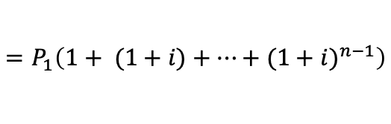
$$Amortization Table$$
$$i=0.03$$
Time $$k$$ | Payment $$C$$ | Interest Earned $$I_{k}$$ | Principal Adjustment $$P_{k}$$ | Book Value $$B_{k}$$
0 |  |  |  | $$B_{0}=P=1111.51$$
1 | 60 | 33.35 | 26.65 | $$B_{1}=1084.86$$
2 | 60 | 32.55 | 27.45 | $$B_{2}=1057.41$$
3 | 60 | 31.72 | 28.28 | $$B_{3}=1029.13$$
4 | 60 | 30.87 | 29.13 | $$B_{4}=R=1000$$
$$General Remarks:$$
$$1. \left\{P_{1},P_{2},…,P_{n}\right\} is a geometric sequence with common ratio r=1+i$$
$$2. \sum{P_{k}}=P_{1}+P_{2}+…+P_{n}$$
$$=P_{1}\left(1+ (1+i)+…+{(1+i)}^{n−1}\right)$$

Slide 55

$$Amortization Table$$
$$i=0.03$$
Time $$k$$ | Payment $$C$$ | Interest Earned $$I_{k}$$ | Principal Adjustment $$P_{k}$$ | Book Value $$B_{k}$$
0 |  |  |  | $$B_{0}=P=1111.51$$
1 | 60 | 33.35 | 26.65 | $$B_{1}=1084.86$$
2 | 60 | 32.55 | 27.45 | $$B_{2}=1057.41$$
3 | 60 | 31.72 | 28.28 | $$B_{3}=1029.13$$
4 | 60 | 30.87 | 29.13 | $$B_{4}=R=1000$$
$$General Remarks:$$
$$1. \left\{P_{1},P_{2},…,P_{n}\right\} is a geometric sequence with common ratio r=1+i$$
$$2. \sum{P_{k}}=P_{1}+P_{2}+…+P_{n}$$
$$=P_{1}\left(1+ (1+i)+…+{(1+i)}^{n−1}\right)$$
$$=P_{1}∙s_{\overline{n}|}$$

Slide 56

$$Amortization Table$$
$$i=0.03$$
Time $$k$$ | Payment $$C$$ | Interest Earned $$I_{k}$$ | Principal Adjustment $$P_{k}$$ | Book Value $$B_{k}$$
0 |  |  |  | $$B_{0}=P=1111.51$$
1 | 60 | 33.35 | 26.65 | $$B_{1}=1084.86$$
2 | 60 | 32.55 | 27.45 | $$B_{2}=1057.41$$
3 | 60 | 31.72 | 28.28 | $$B_{3}=1029.13$$
4 | 60 | 30.87 | 29.13 | $$B_{4}=R=1000$$
$$General Remarks:$$
$$1. \left\{P_{1},P_{2},…,P_{n}\right\} is a geometric sequence with common ratio r=1+i$$
$$2. \sum{P_{k}}=P_{1}+P_{2}+…+P_{n}$$
$$=P_{1}\left(1+ (1+i)+…+{(1+i)}^{n−1}\right)$$
$$=P_{1}∙s_{\overline{n}|}$$
$$=P−R$$

Slide 57
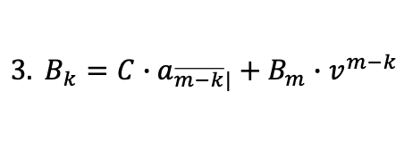
$$Amortization Table$$
$$i=0.03$$
Time $$k$$ | Payment $$C$$ | Interest Earned $$I_{k}$$ | Principal Adjustment $$P_{k}$$ | Book Value $$B_{k}$$
0 |  |  |  | $$B_{0}=P=1111.51$$
1 | 60 | 33.35 | 26.65 | $$B_{1}=1084.86$$
2 | 60 | 32.55 | 27.45 | $$B_{2}=1057.41$$
3 | 60 | 31.72 | 28.28 | $$B_{3}=1029.13$$
4 | 60 | 30.87 | 29.13 | $$B_{4}=R=1000$$
$$General Remarks:$$
$$1. \left\{P_{1},P_{2},…,P_{n}\right\} is a geometric sequence with common ratio r=1+i$$
$$2. \sum{P_{k}}=P_{1}+P_{2}+…+P_{n}$$
$$=P_{1}\left(1+ (1+i)+…+{(1+i)}^{n−1}\right)$$
$$=P_{1}∙s_{\overline{n}|}$$
$$=P−R$$
$$3. B_{k}=C∙a_{\overline{m−k}|}+B_{m}∙v^{m−k}$$

Slide 58
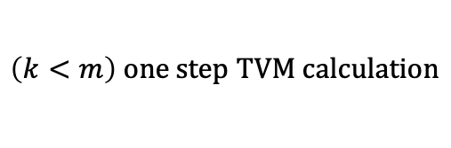
$$Amortization Table$$
$$i=0.03$$
Time $$k$$ | Payment $$C$$ | Interest Earned $$I_{k}$$ | Principal Adjustment $$P_{k}$$ | Book Value $$B_{k}$$
0 |  |  |  | $$B_{0}=P=1111.51$$
1 | 60 | 33.35 | 26.65 | $$B_{1}=1084.86$$
2 | 60 | 32.55 | 27.45 | $$B_{2}=1057.41$$
3 | 60 | 31.72 | 28.28 | $$B_{3}=1029.13$$
4 | 60 | 30.87 | 29.13 | $$B_{4}=R=1000$$
$$General Remarks:$$
$$1. \left\{P_{1},P_{2},…,P_{n}\right\} is a geometric sequence with common ratio r=1+i$$
$$2. \sum{P_{k}}=P_{1}+P_{2}+…+P_{n}$$
$$=P_{1}\left(1+ (1+i)+…+{(1+i)}^{n−1}\right)$$
$$=P_{1}∙s_{\overline{n}|}$$
$$=P−R$$
$$3. B_{k}=C∙a_{\overline{m−k}|}+B_{m}∙v^{m−k}$$
$$\left(k<m\right) one step TVM calculation$$

Slide 59
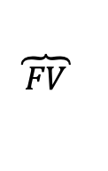
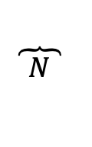
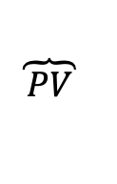
$$Amortization Table$$
$$i=0.03$$
Time $$k$$ | Payment $$C$$ | Interest Earned $$I_{k}$$ | Principal Adjustment $$P_{k}$$ | Book Value $$B_{k}$$
0 |  |  |  | $$B_{0}=P=1111.51$$
1 | 60 | 33.35 | 26.65 | $$B_{1}=1084.86$$
2 | 60 | 32.55 | 27.45 | $$B_{2}=1057.41$$
3 | 60 | 31.72 | 28.28 | $$B_{3}=1029.13$$
4 | 60 | 30.87 | 29.13 | $$B_{4}=R=1000$$
$$General Remarks:$$
$$1. \left\{P_{1},P_{2},…,P_{n}\right\} is a geometric sequence with common ratio r=1+i$$
$$2. \sum{P_{k}}=P_{1}+P_{2}+…+P_{n}$$
$$=P_{1}\left(1+ (1+i)+…+{(1+i)}^{n−1}\right)$$
$$=P_{1}∙s_{\overline{n}|}$$
$$=P−R$$
$$3. B_{k}=C∙a_{\overline{m−k}|}+B_{m}∙v^{m−k}$$
$$\left(k<m\right) one step TVM calculation$$
$$\overbrace{ PV }$$
$$\overbrace{ N }$$
$$\overbrace{ FV }$$

Slide 60

$$Amortization Table$$
$$i=0.03$$
Time $$k$$ | Payment $$C$$ | Interest Earned $$I_{k}$$ | Principal Adjustment $$P_{k}$$ | Book Value $$B_{k}$$
0 |  |  |  | $$B_{0}=P=1111.51$$
1 | 60 | 33.35 | 26.65 | $$B_{1}=1084.86$$
2 | 60 | 32.55 | 27.45 | $$B_{2}=1057.41$$
3 | 60 | 31.72 | 28.28 | $$B_{3}=1029.13$$
4 | 60 | 30.87 | 29.13 | $$B_{4}=R=1000$$
$$General Remarks:$$
$$1. \left\{P_{1},P_{2},…,P_{n}\right\} is a geometric sequence with common ratio r=1+i$$
$$2. \sum{P_{k}}=P_{1}+P_{2}+…+P_{n}$$
$$=P_{1}\left(1+ (1+i)+…+{(1+i)}^{n−1}\right)$$
$$=P_{1}∙s_{\overline{n}|}$$
$$=P−R$$
$$3. B_{k}=C∙a_{\overline{m−k}|}+B_{m}∙v^{m−k}$$
$$\left(k<m\right) one step TVM calculation$$
$$P=C∙a_{\overline{n}|}+R∙v^{n}$$

Slide 61

$$Amortization Table$$
$$i=0.03$$
Time $$k$$ | Payment $$C$$ | Interest Earned $$I_{k}$$ | Principal Adjustment $$P_{k}$$ | Book Value $$B_{k}$$
0 |  |  |  | $$B_{0}=P=1111.51$$
1 | 60 | 33.35 | 26.65 | $$B_{1}=1084.86$$
2 | 60 | 32.55 | 27.45 | $$B_{2}=1057.41$$
3 | 60 | 31.72 | 28.28 | $$B_{3}=1029.13$$
4 | 60 | 30.87 | 29.13 | $$B_{4}=R=1000$$
$$General Remarks:$$
$$1. \left\{P_{1},P_{2},…,P_{n}\right\} is a geometric sequence with common ratio r=1+i$$
$$2. \sum{P_{k}}=P_{1}+P_{2}+…+P_{n}$$
$$=P_{1}\left(1+ (1+i)+…+{(1+i)}^{n−1}\right)$$
$$=P_{1}∙s_{\overline{n}|}$$
$$=P−R$$
$$3. B_{k}=C∙a_{\overline{m−k}|}+B_{m}∙v^{m−k}$$
$$\left(k<m\right) one step TVM calculation$$
$$P=C∙a_{\overline{n}|}+R∙v^{n}$$
$$B_{k}=C∙a_{\overline{n−k}|}+R∙v^{n−k}$$

